Slide 1
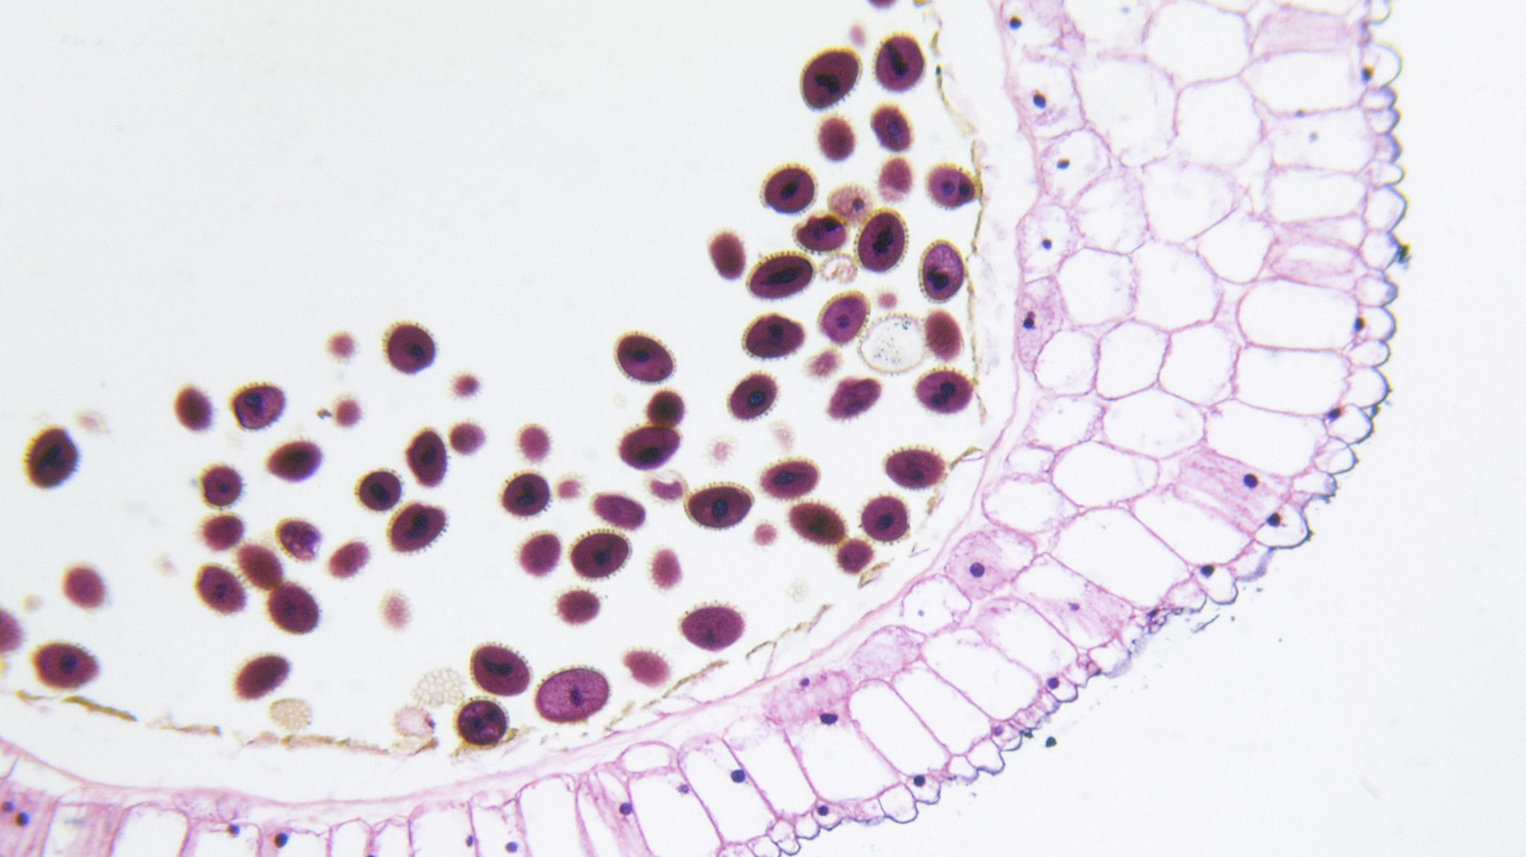
PANCREATITIS
Chrissy McCain MSN, RN
2025

Slide 2
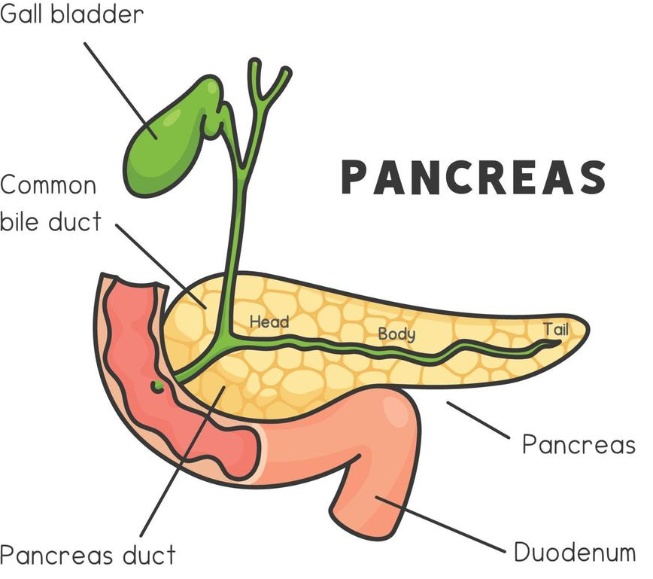
ANATOMY & PHYSIOLOGY
Functions that help regulate blood sugar & digest and absorb nutrients
Endocrine Function (Hormone production & secretion by the islets of Langerhans)
  For regulating blood glucose:
  - Insulin: allows for the uptake of glucose by the cells as energy
  - Glucagon: signals the liver to release stored glucose when blood sugar is low

Slide 3
ANATOMY & PHYSIOLOGY
Exocrine Function (Digestive enzyme production & secretion)
  Amylase: breaks down carbohydrates into simple sugars
  Lipase: breaks down fats into fatty acids and glycerol
  Proteases: break down proteins into amino acids
  Enzymes are normally released inactive into the digestive tract
  They are activated once they reach the small intestine

Slide 4
PATHOPHYSIOLOGY
Injury to pancreatic tissue causes premature activation of enzymes within the pancreas
The enzymes (especially trypsin) start to digest pancreatic tissue, leading to inflammation, edema, and tissue damage and necrosis

Slide 5
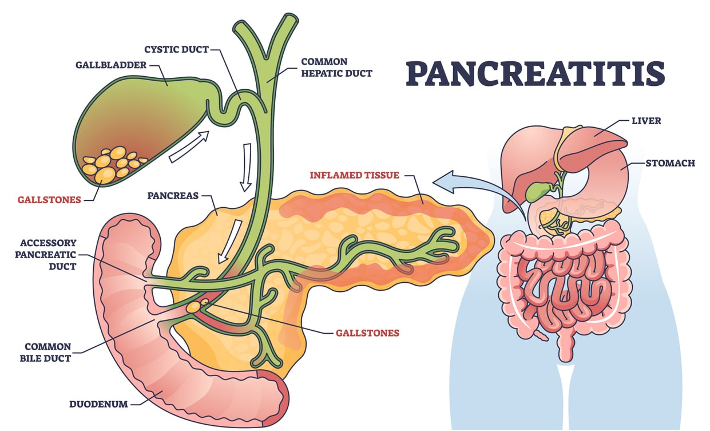

Slide 6
ETIOLOGY / CAUSES
Acronym:
“I get smashed”
I – Idiopathic – unknown cause
G – Gallstones (main causes!)
E – ETOH (Alcohol – main causes!)
T – Tumors & Trauma (more of a cause for Chronic)
S – Steroids
M – Mumps Infex
A – Auto immune
S – Scorpion sting (very rare)
H – Hyperlipidemia
E – ERCP (endoscope procedure that looks at panc. & bile ducts)
D – Drugs (ie: diuretics, Azathiprine [anti-rejection, RA med])

Slide 7
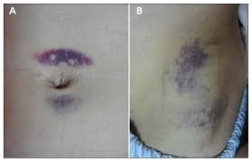
SIGNS & SYMPTOMS
• Sudden, severe epigastric pain often radiating to the back
• Nausea & vomiting • Fever
• Fat in stool (lack of bile to emulsify fats
• Jaundice (if bile duct obstruction)
• Tachycardia & hypotension in shock w/severe cases
Assessment findings:
  Common: Abdominal tenderness and guarding
  Rare: Cullens sign – discoloration around the umbilicus “like a C”
  Rare: Grey-Turners sign – bruising on the flanks or “sides”

Slide 8
DIAGNOSTIC TESTS
Blood Tests (all elevated)
Amylase & Lipase
WBCs (inflammation/ infection)
AST & ALT (if gallstones or liver involvement)
Blood glucose (due to pancreatic beta-cell production)
Imaging Studies
CT Scan – preferred for diagnosis and assessment of severity
Ultrasound – to check for gallstones or bile duct abnormalities
MRI: possible for complex cases
*Common finding: HYPOCALCEMIA

Slide 9
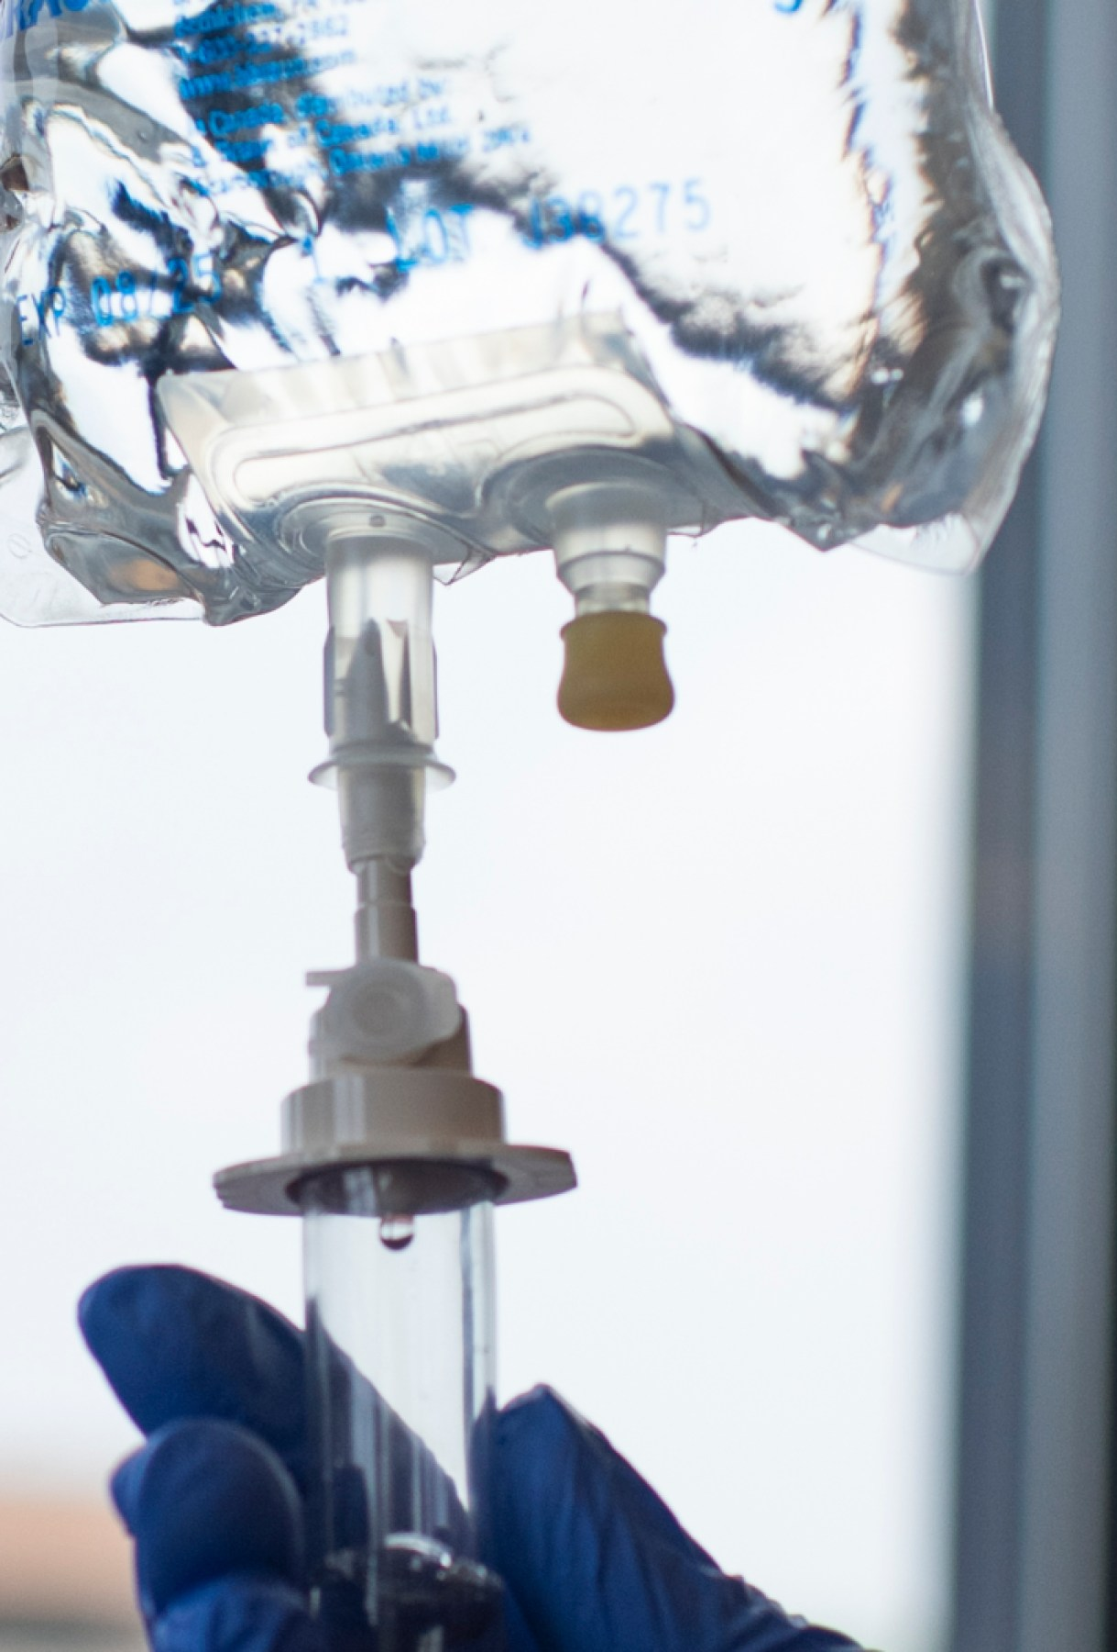
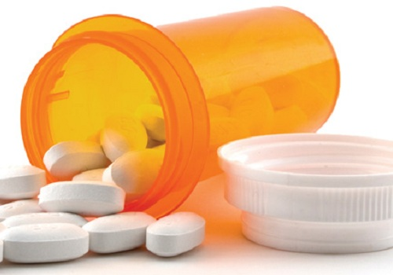
TREATMENT
Fluid resuscitation – often high volume fluids, helps prevent hypovolemia & shock
Pain management – Opioids or Tylenol (avoid use of NSAIDs – r/t GI upset/bleeding)
Electrolyte balance – Correcting imbalances (incl. hypocalcemia)
NPO – Let the pancreas REST!!
Antibiotics for infection, pseudocysts
Surgical interventions: removal of gallstones, draining pseudocysts, or pancreatic debridement if severe
Enzyme replacement therapy for chronic pancreatitis

Slide 10
COMPLICATIONS
Acute Complications:
  Pancreatic Necrosis: Tissue death requiring surgery.
  Pseudocysts: Fluid-filled sacs that can become infected.
  Organ Failure: Kidney, liver, or respiratory failure in severe cases.
Chronic Complications:
  Diabetes Mellitus: Due to damage to insulin-producing cells.
  Chronic Pain: Ongoing abdominal pain.
  Pancreatic Cancer: Long-term risk due to chronic inflammation.
  Malabsorption: Due to insufficient enzyme production.

Slide 11

BYE!!
Thank you
for allowing me to rest & recover!

